Slide 1

Gender european women in tech
Panos Syrgkanis
Anh Huynh

Slide 2
Contents
EL MODEL & Introduction
Analysis with data and charts
api cOding
SQL SCRIPT

Slide 3
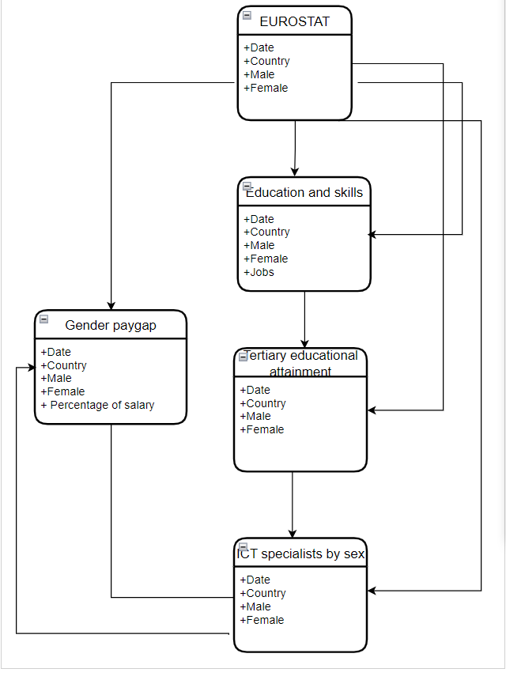
Introduction
The gender gap in information and communications technology(ICT): less women than men in Technologies
ER Model:
Early education and skills
Tertiary educational attainment
Gender paygap
ICT specialistes by sex
Analysing European statistics database to explain the gap
Data /metadata sources: from EUROSTAT/ WORLD ECONOMY FORUM
https://ec.europa.eu/eurostat
https://www3.weforum.org/docs/WEF_GGGR_2020.pdf

Slide 4
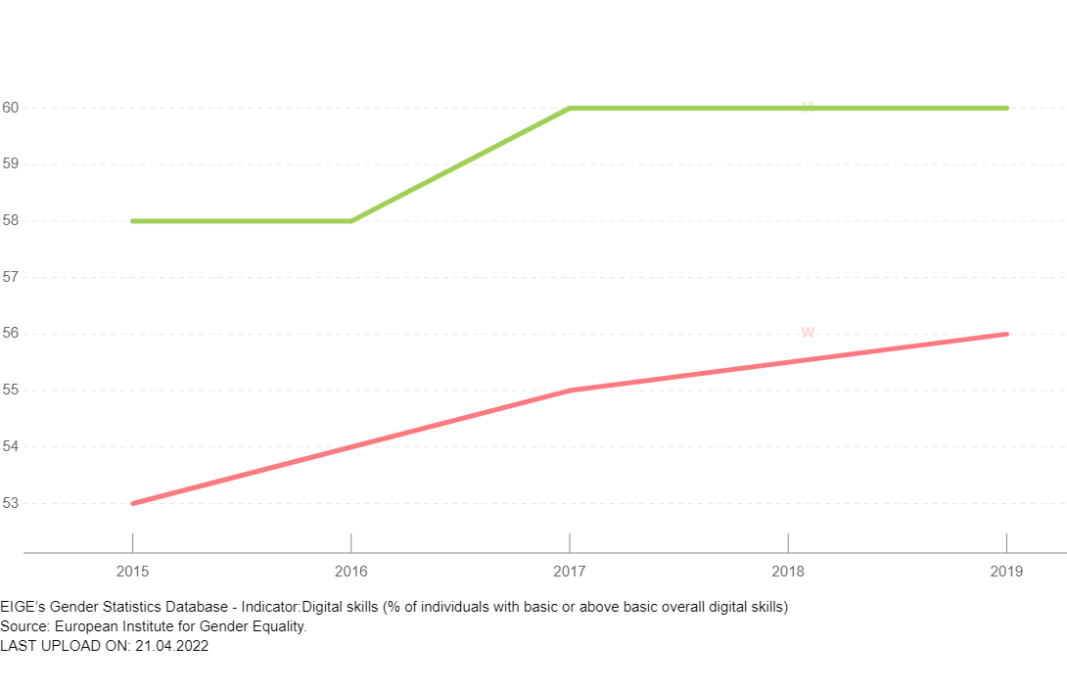
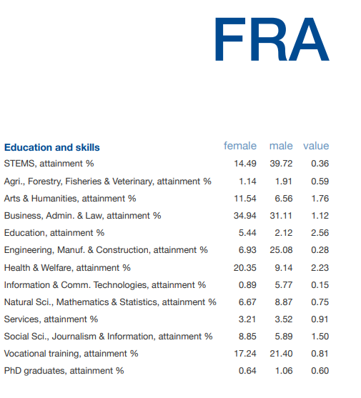
Education & skills
The early education, where female students are less encouraged and supported to choose ICT related studies
Early adopted attitudes and social environment form gender gaps
in the future work life.
Example:
Digital skills (% of individuals with basic or above basic overall digital skills)

Slide 5
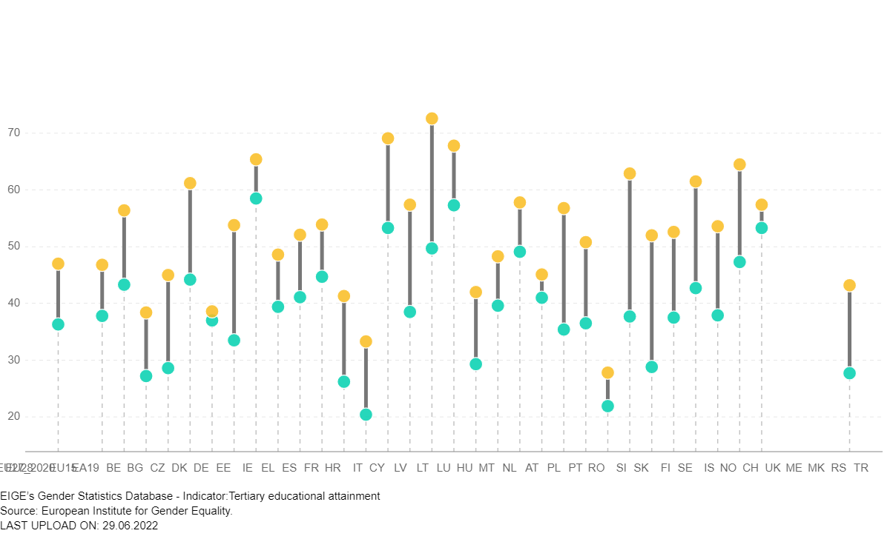
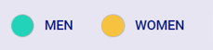
Tertiary educational attainment
Population by educational attainment level, sex and age (%)
The percentage of the population aged 30-34 who have successfully completed studies.
e.g. university, higher technical institution, etc.
Women have higher degree achivements than men
https://eige.europa.eu/gender-statistics/dgs/indicator/eustrat_epsr_eoalm_esll__edat_lfse_03/metadata

Slide 6
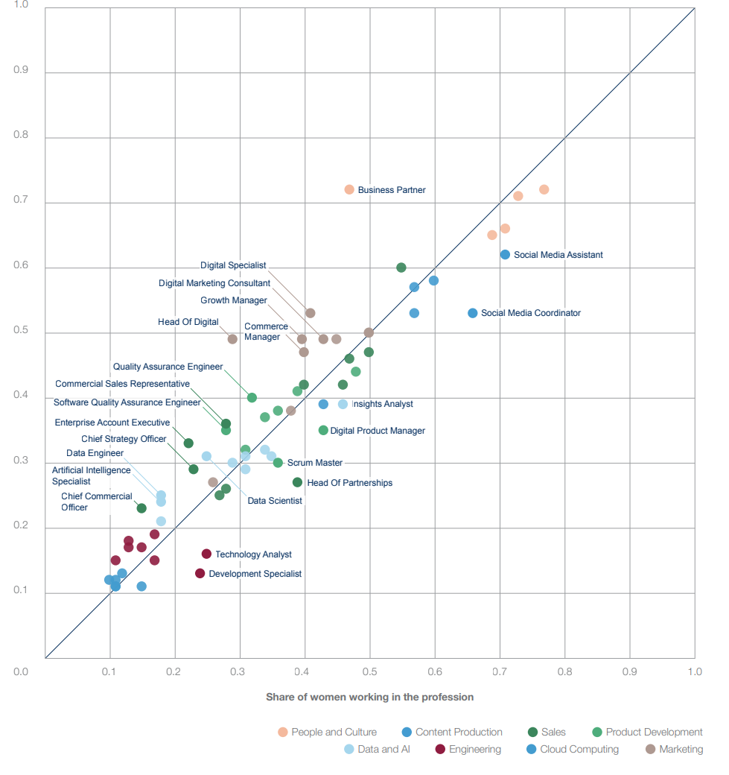
Share of women in occupations by professional cluster contrasted with share of women in the talent pipeline
Source:https://www3.weforum.org/docs/WEF_GGGR_2020.pdf

Slide 7
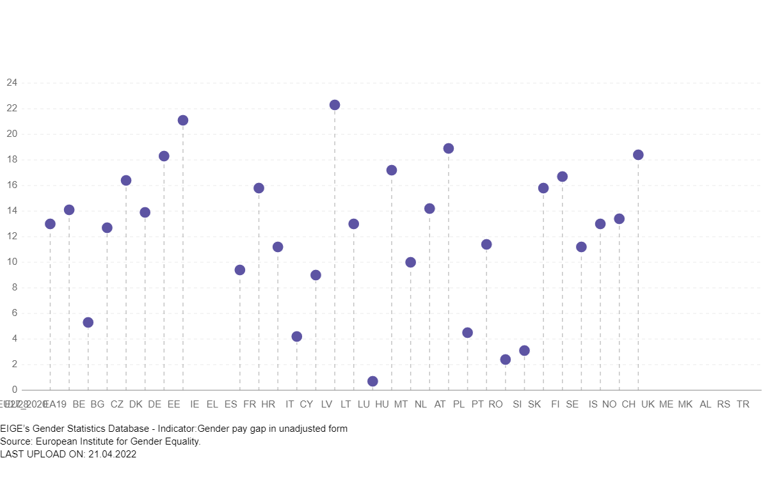
Gender paygap
The difference percentage between average gross hourly earnings of male paid employees and of female paid employees.
Picture of gender inequalities in terms of pay and measures a concept which is broader than the concept of equal pay for equal work.
Pay gap still remains, where women’s salary less than men earn under the same title.
https://eige.europa.eu/gender-statistics/dgs/indicator/eustrat_epsr_eoalm_gelm__tesem180/bar

Slide 8
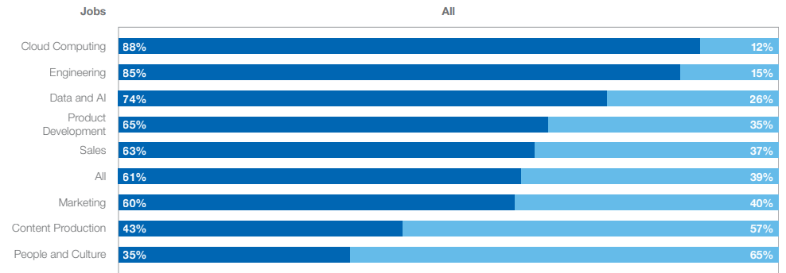
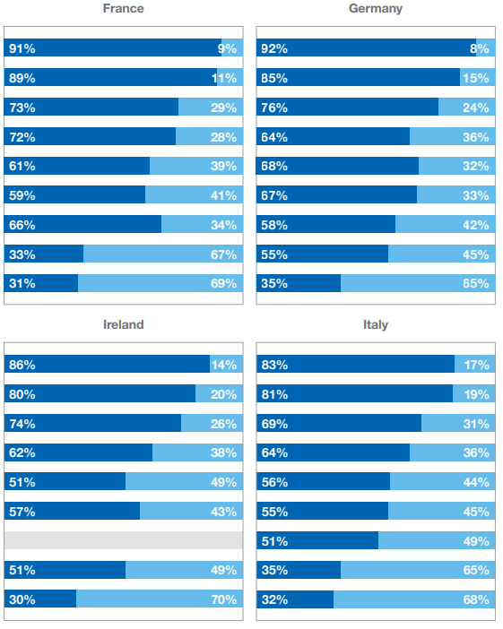

Share of men and women by profession.
Source:https://www3.weforum.org/docs/WEF_GGGR_2020.pdf

Slide 9
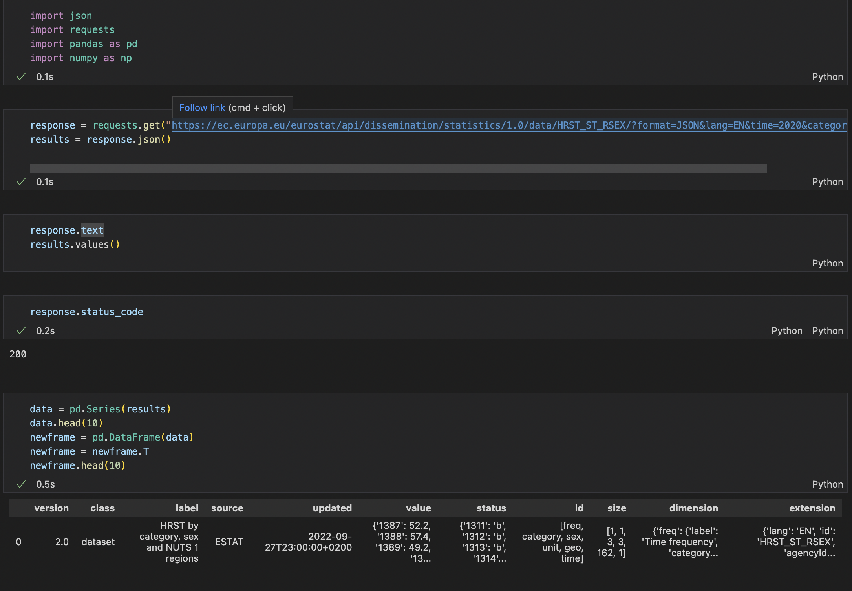

Slide 10
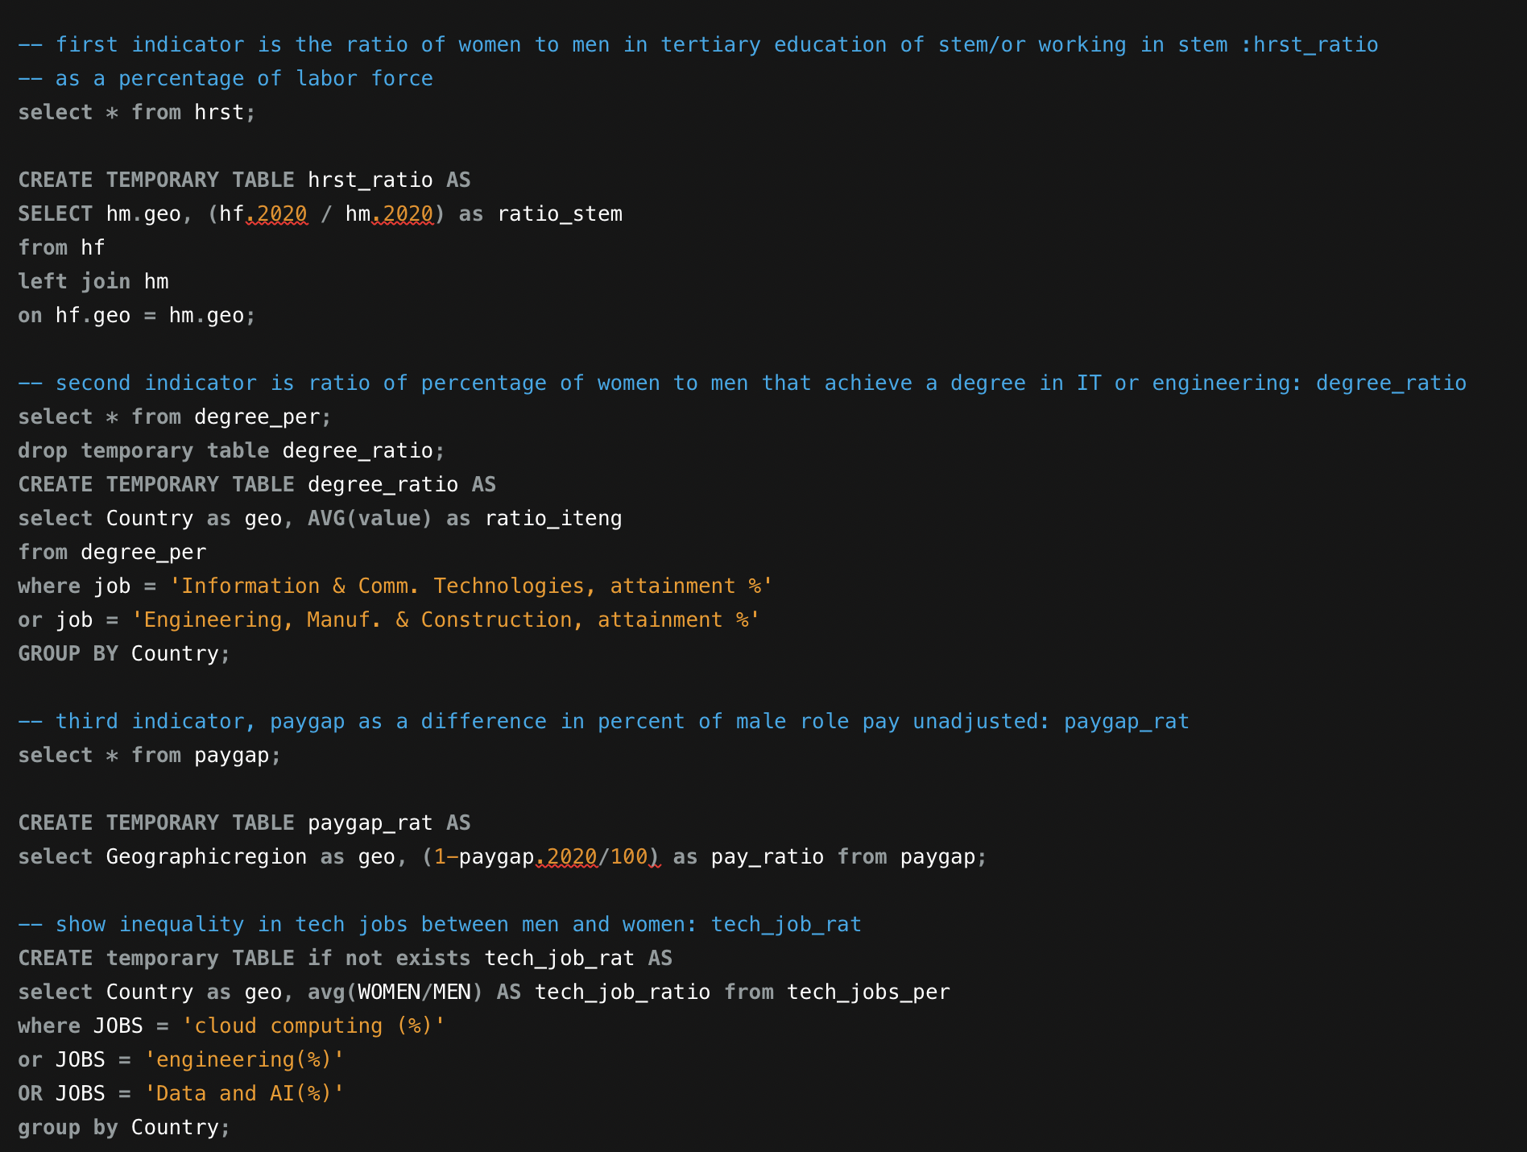

Slide 11
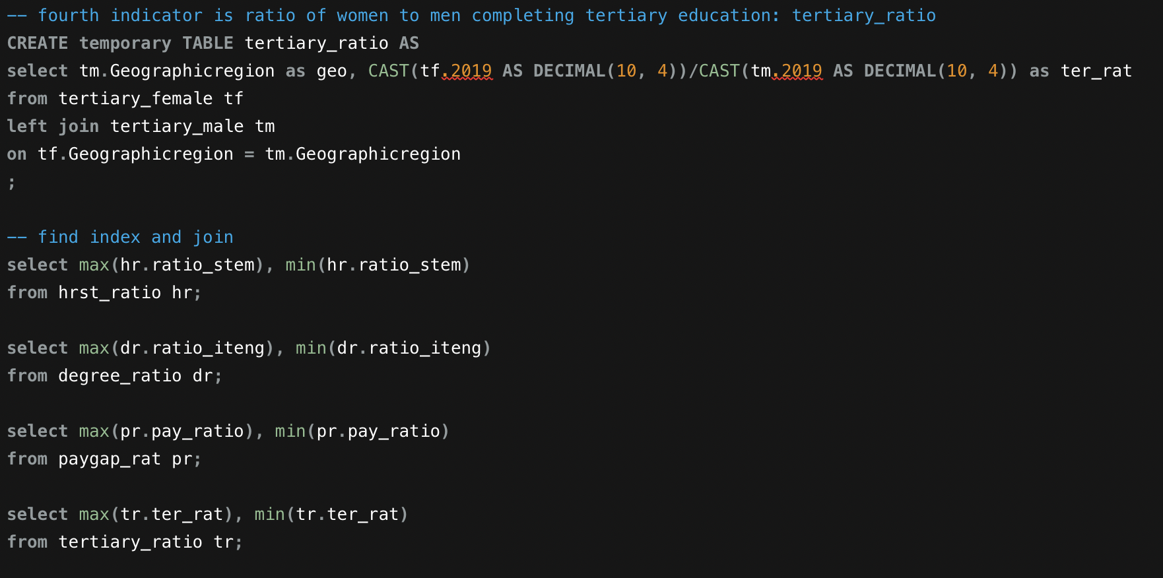

Slide 12
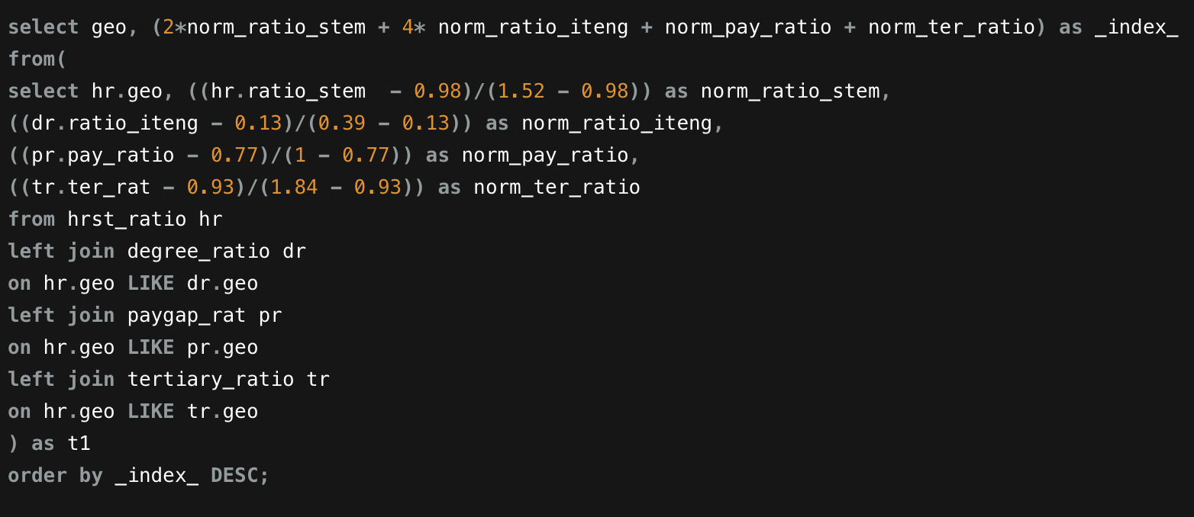

Slide 13
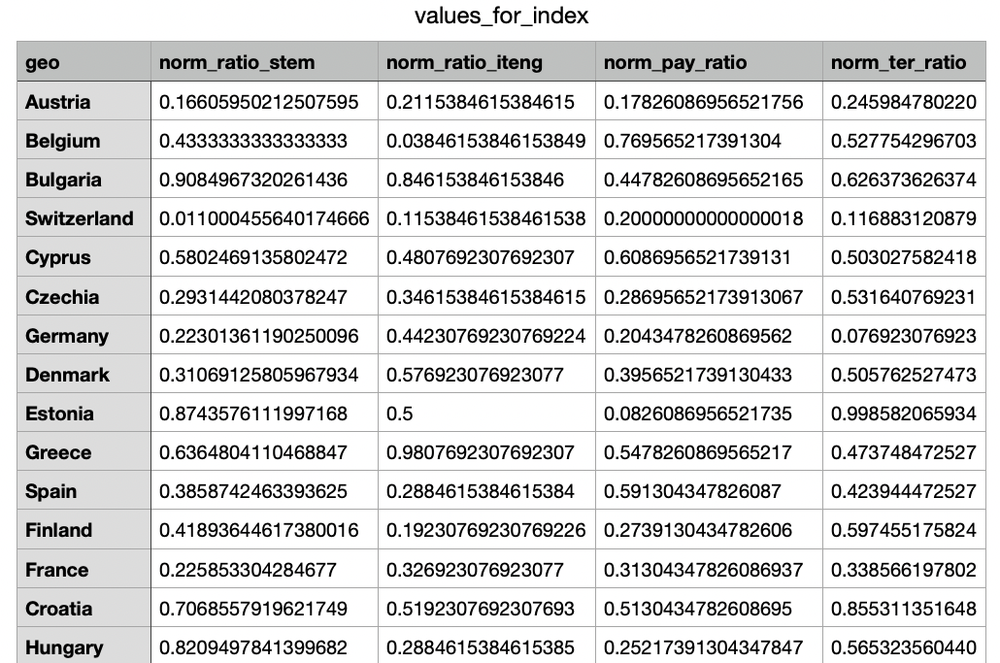

Slide 14
